Slide 1
upLift
Brandon Martinez

Slide 2
The Problem
Working out is intimidating and mysterious to many.
Finding a good workout routine is challenging.
Excel sheets are ugly and don’t work well on phones
Usually, you don’t have a good way of knowing if a routine works well.

Slide 3
My Solution
upLift, a website that allows user to create, share, view and review routines.
upLift allows users to:
find routines that match their needs
Record routines that they create or find
In the future, upLift has the potential to grow into a workout tracking and personal health hub.

Slide 4
How is it built?
upLift uses modern web technologies to provide a smooth and data-driven user experience.
- Next.js 13 – The latest and greatest React framework from Vercel.
- Firestore – Realtime Document (noSQL) database by Google.
- MeiliSearch – An open source full text search API.
- TailwindCSS – CSS framework which provides utility classes for styling components.
- FirebaseAuth – Authentication services on Google’s Firebase platform.
React Icons – SVG icons
UUID – Unique identifier generation
React password checklist – Component for new password creation validation
Excluding the aforementioned, all functionality and components have been designed and developed from the ground up for this project.

Slide 5
Development Environment
neovim – text editor.
Google Chrome, Safari – Web browsers used in testing
React Devtools Extension – Chrome extension for React debugging(viewing component state, props, etc.)
Git – Source control and version management
Github – Git repository hosting

Slide 6
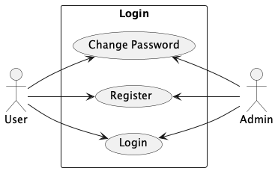
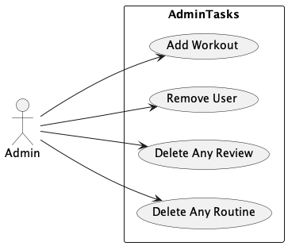
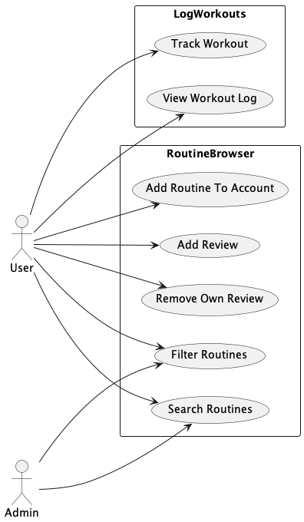
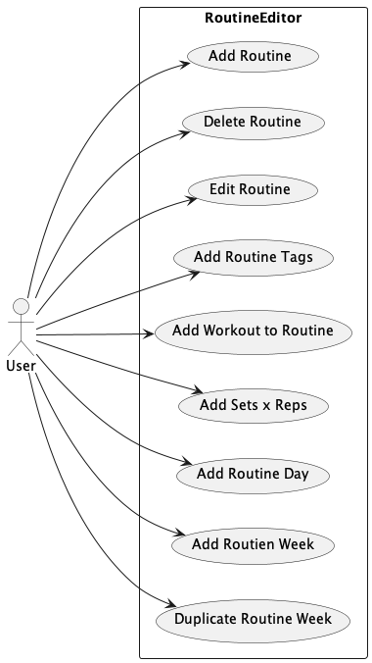
Use Case Diagrams

Slide 7
Notable Changes to Usecases
Admin user is completely removed. As a result, all admin related usecases are not necessary.
Routine Filtering is not necessary. Instead, tags are text searchable.
Workout Tracking changed to be a nice-to-have feature

Slide 8
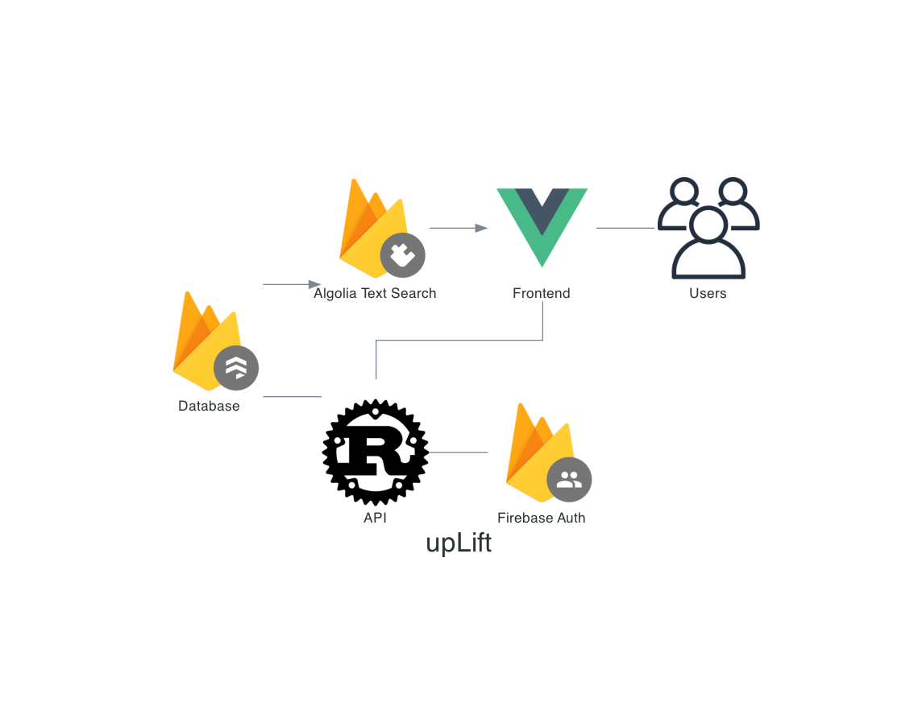
Original System Architechture Diagram

Slide 9
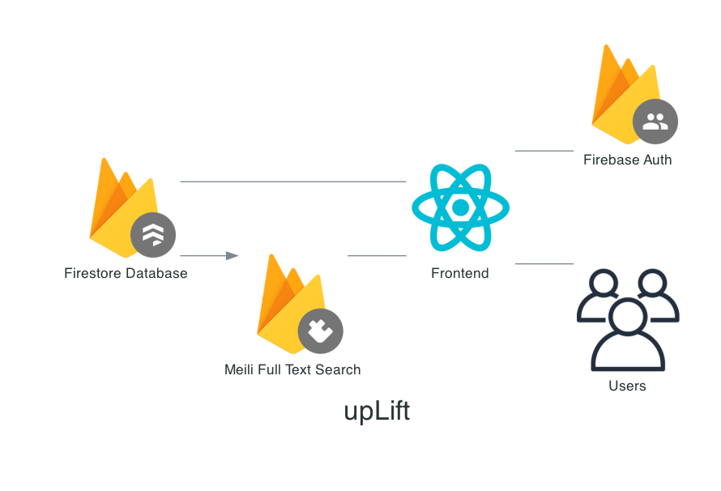
Updated System Architecture Diagram

Slide 10
Change Rationale
Backend completely removed because firebase functions as a client side library that requires no custom backend.
Vue/Nuxt abandoned in favor of more mature and stable React/Next.js
Algolia replaced with open source MeiliSearch.

Slide 11
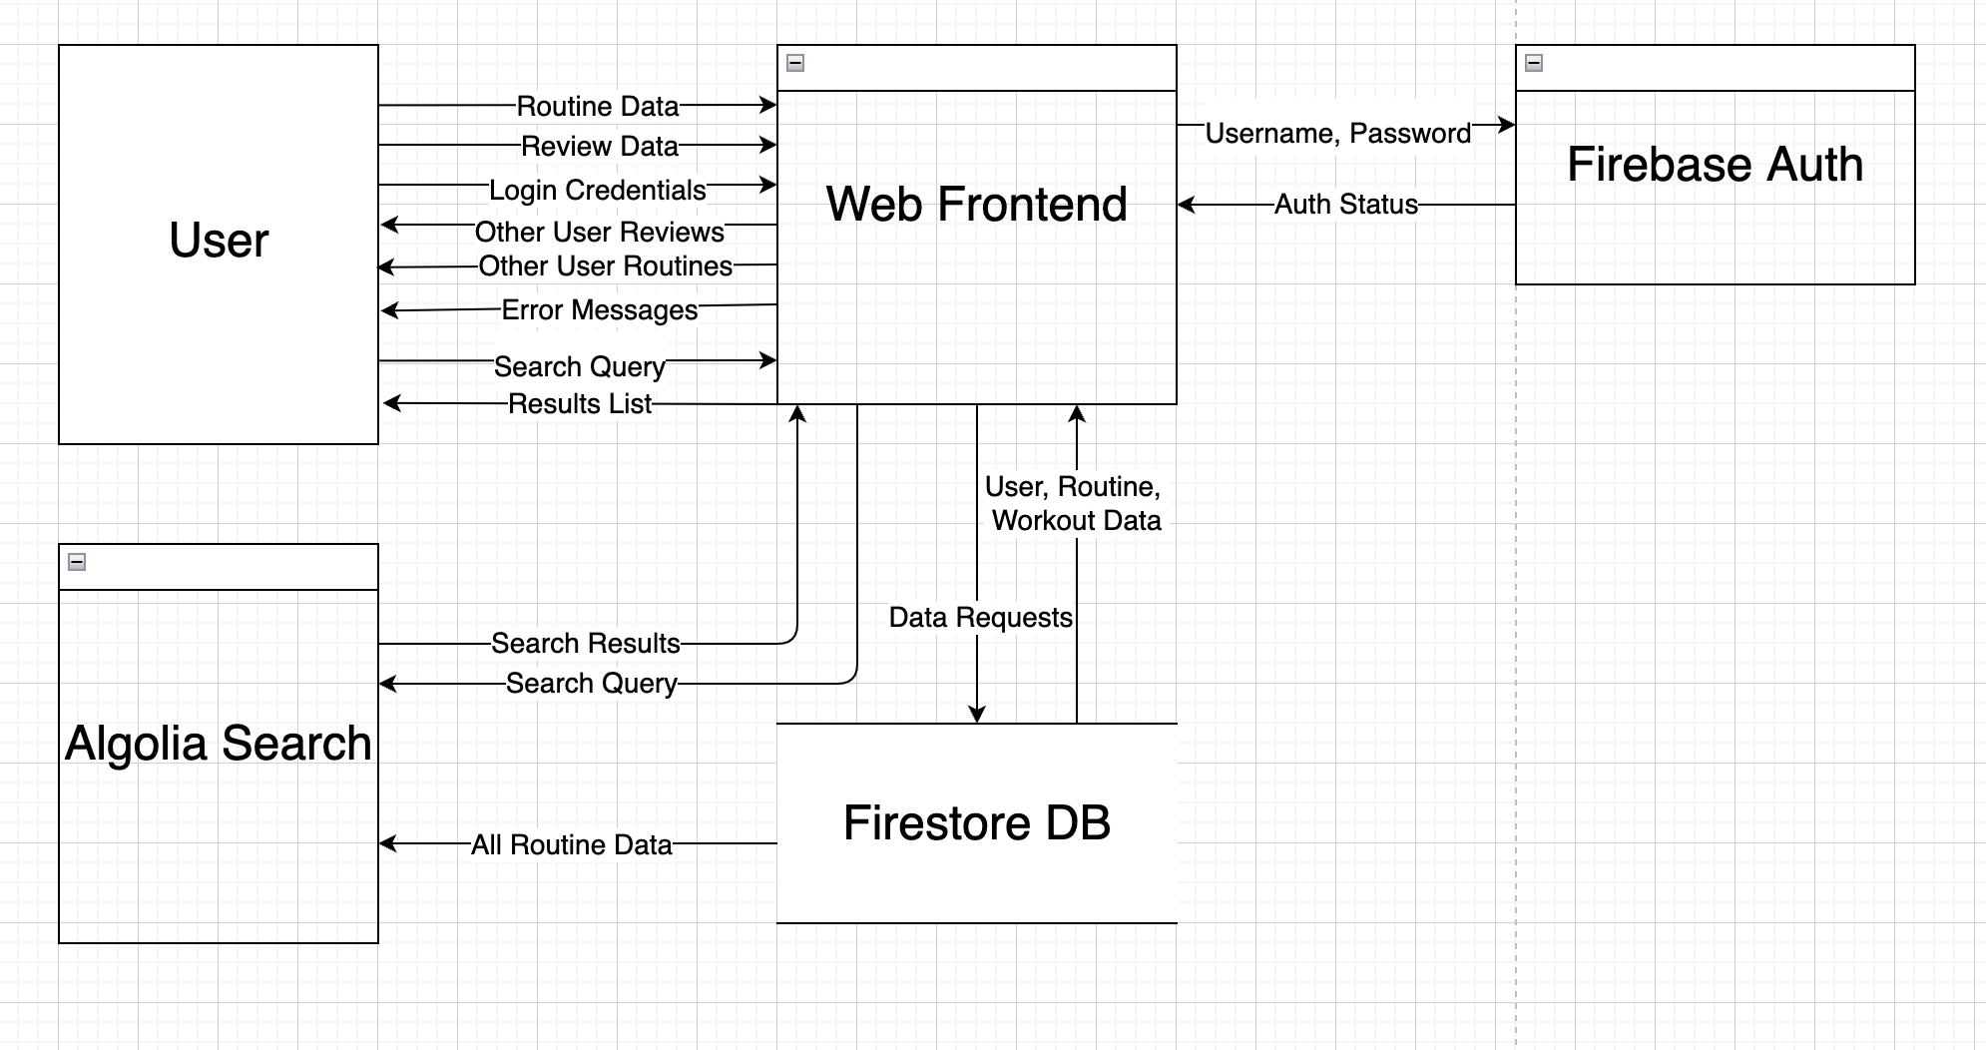
Data Flow Diagram
Changes:
Algolia replaced with Meili.

Slide 12
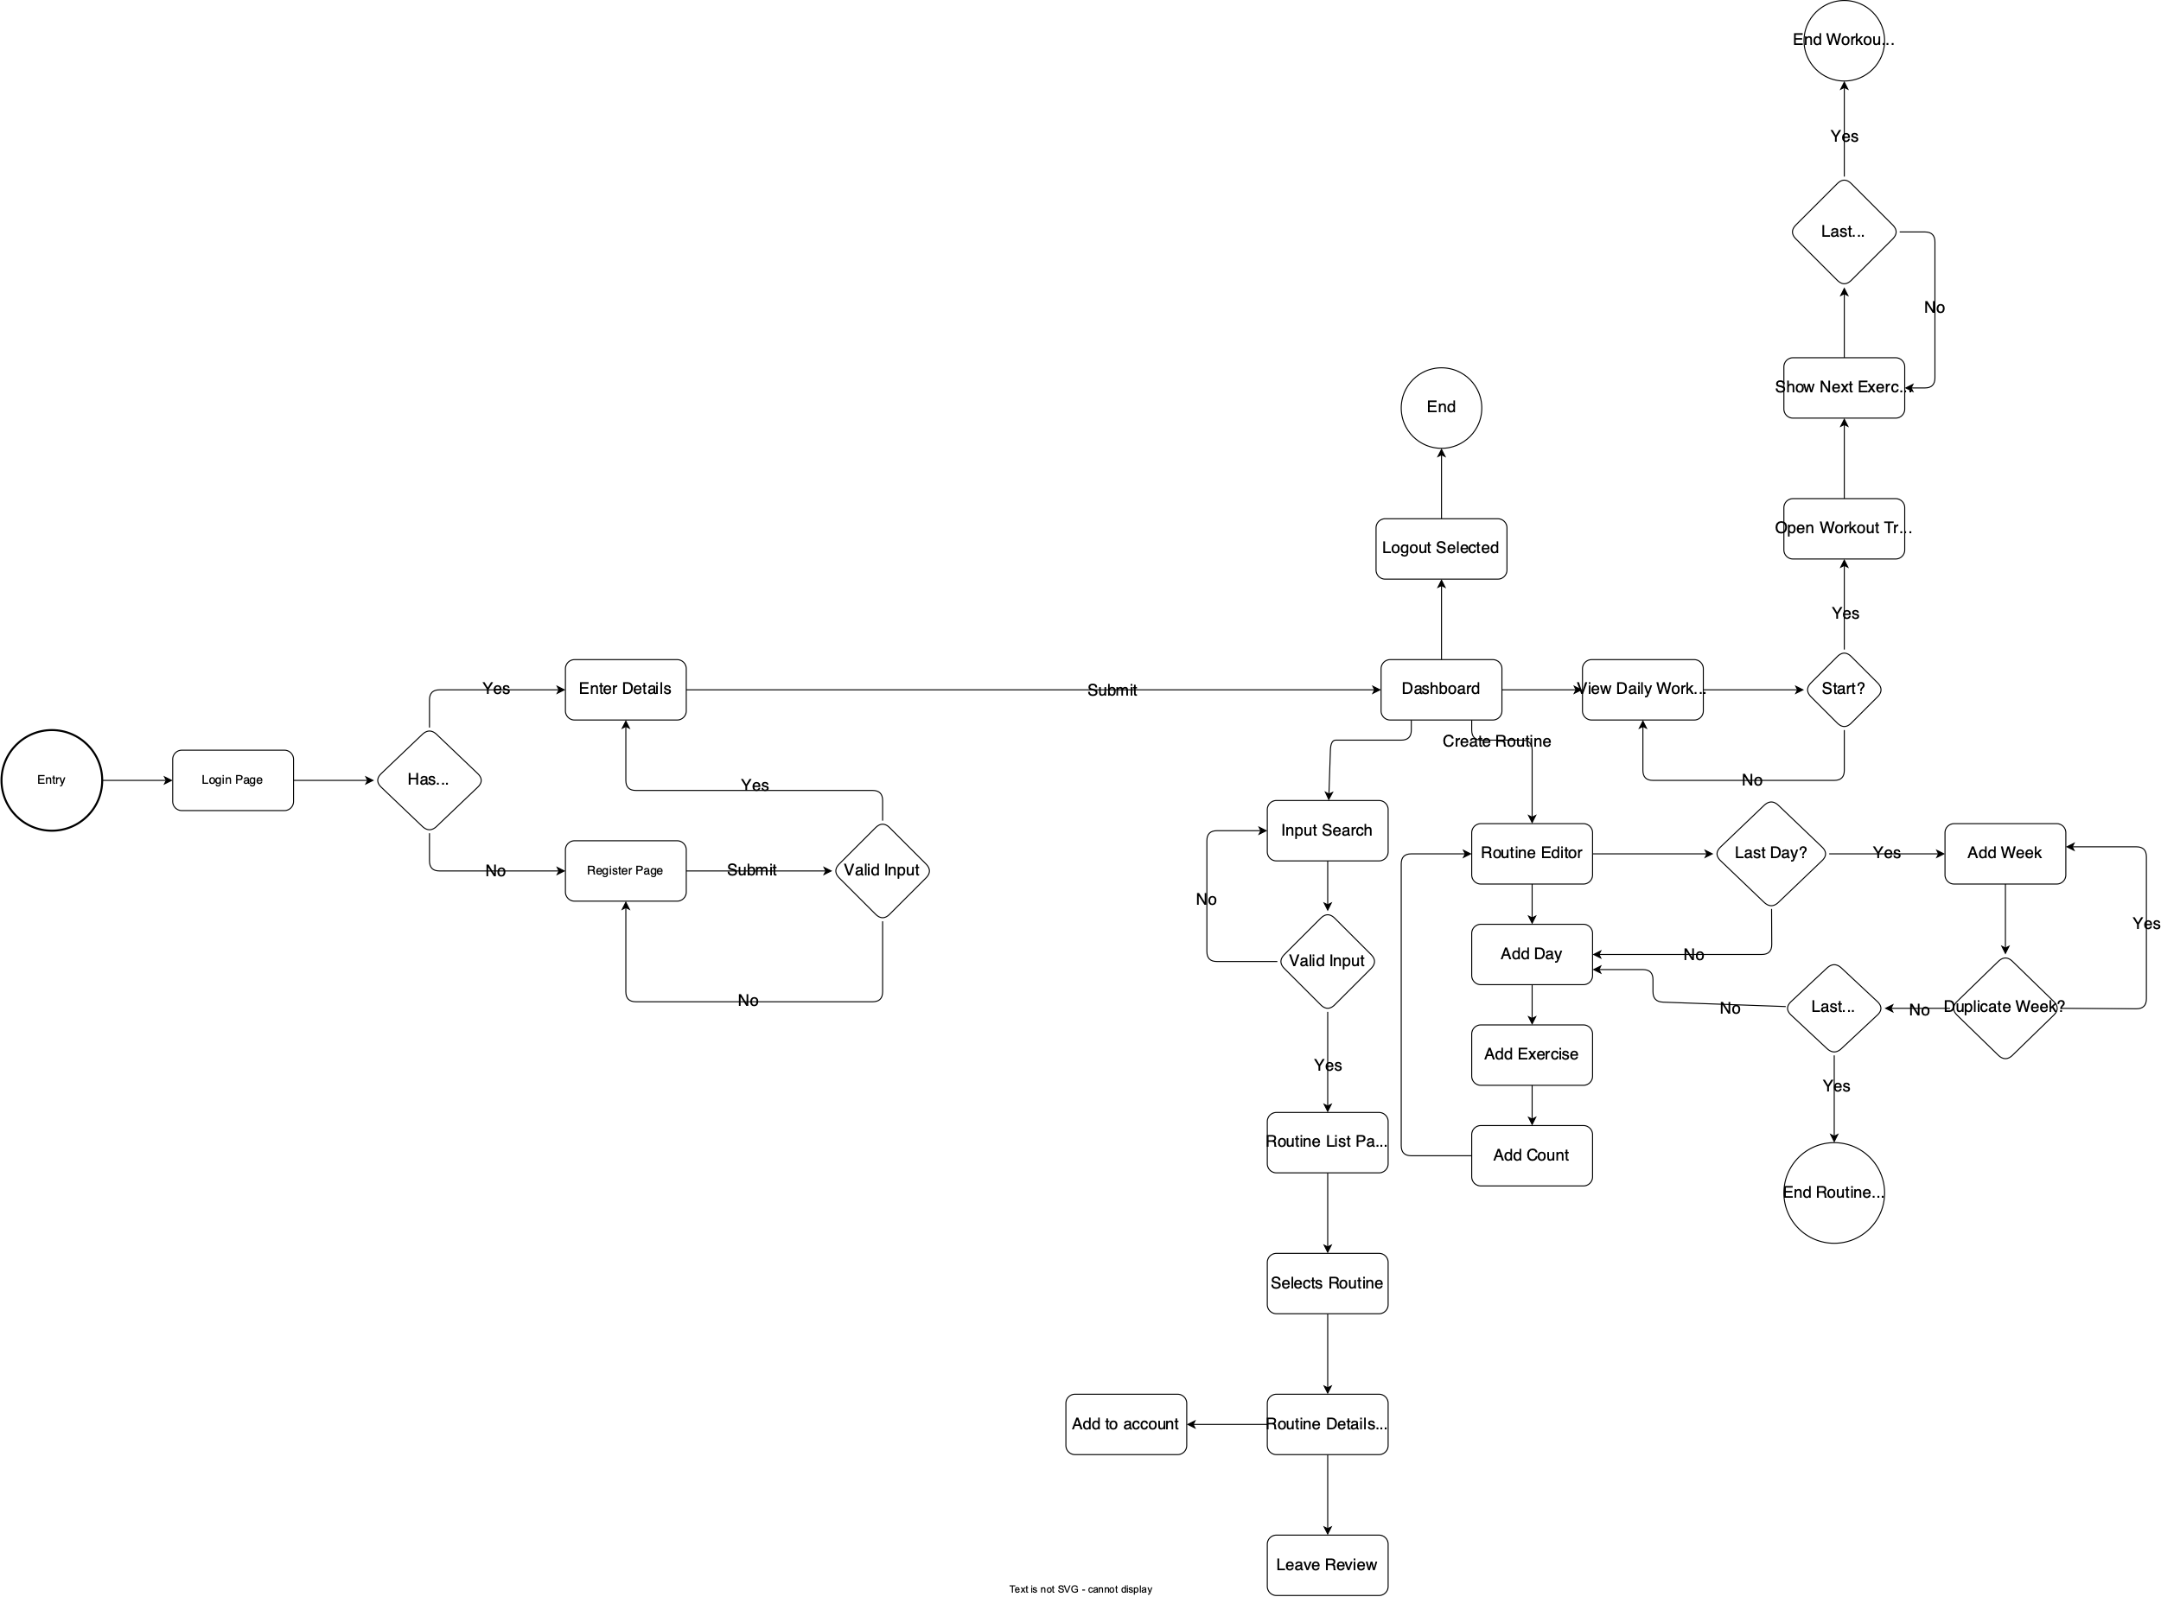
User Flow Diagram

Slide 13
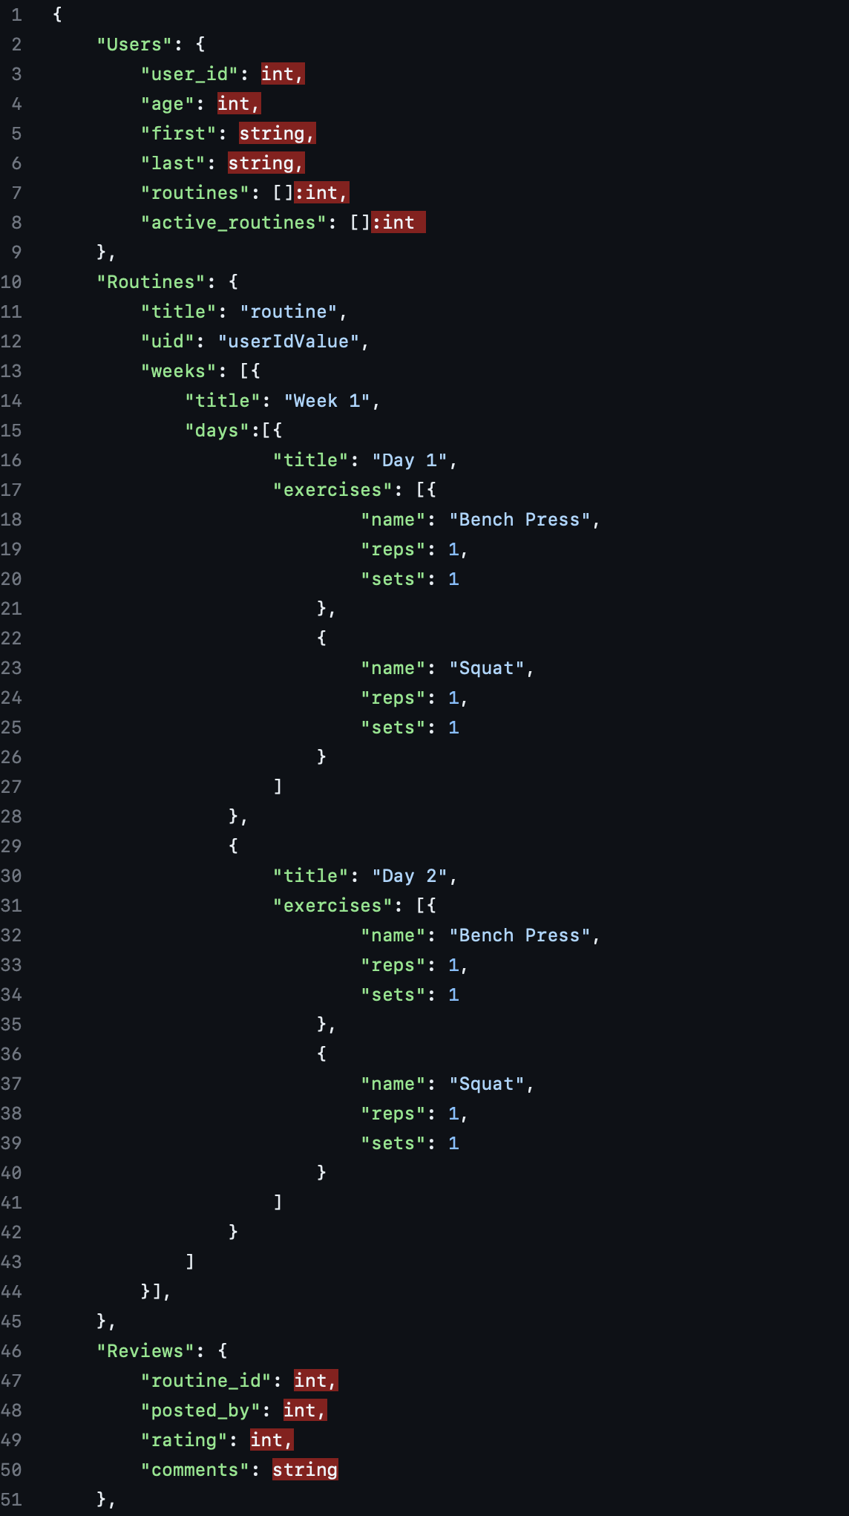
Database Definitions

Slide 14
Testing Cases and Results
-Show Excel Doc-

Slide 15
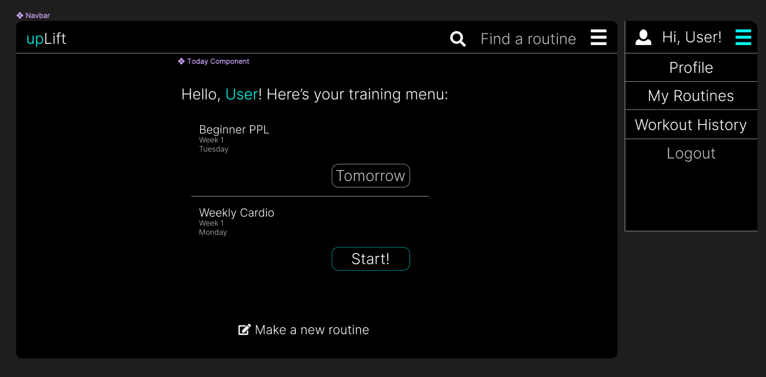
Screen Layouts

Slide 16
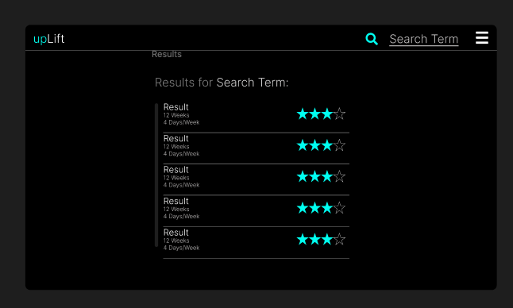

Slide 17
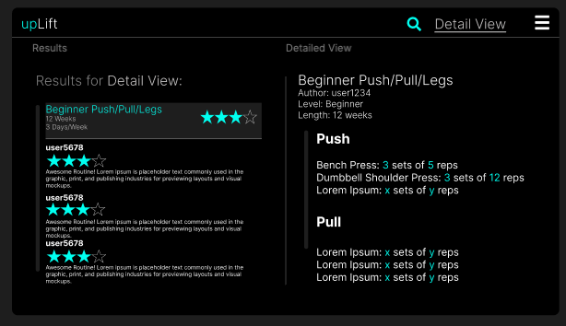

Slide 18
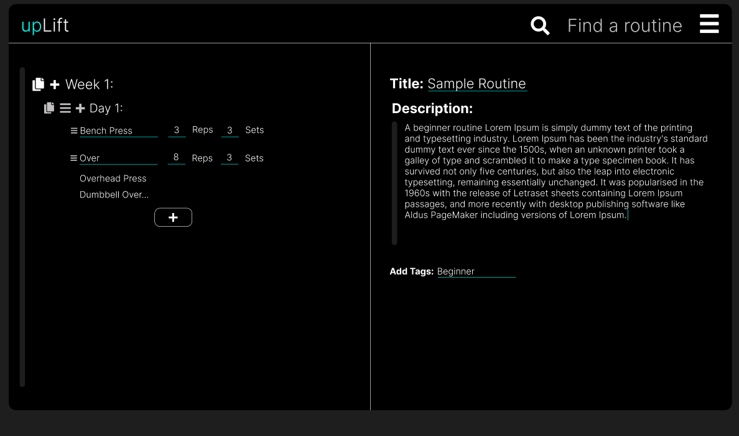

Slide 19
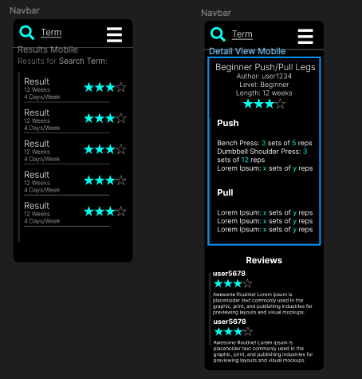
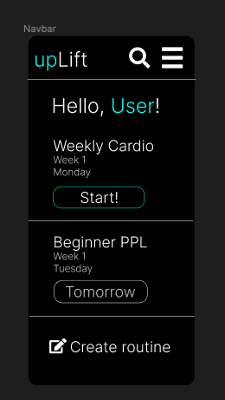
Mobile Layouts

Slide 20
Live Test
Let’s see it in action.

Slide 21
Bonus! My Development Workflow
-Live Demo-

Slide 22
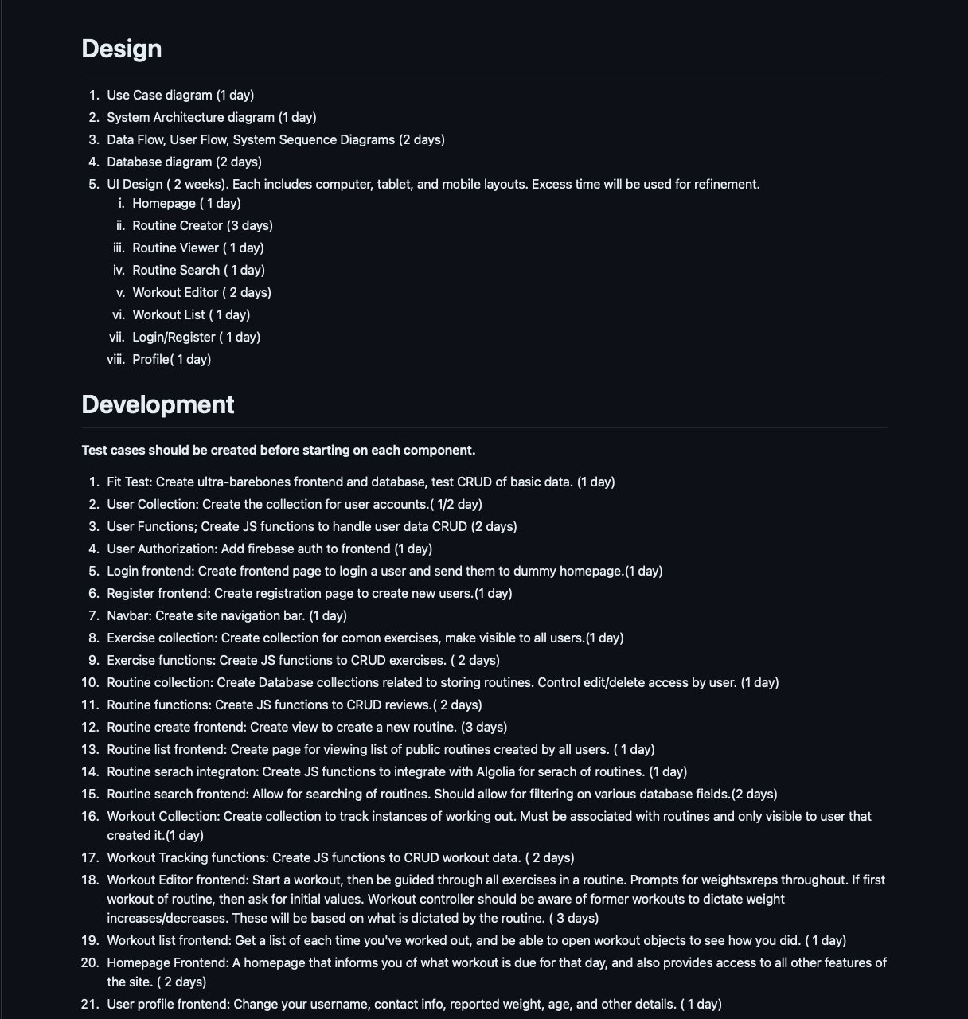
Development Timeline(Original)

Slide 23
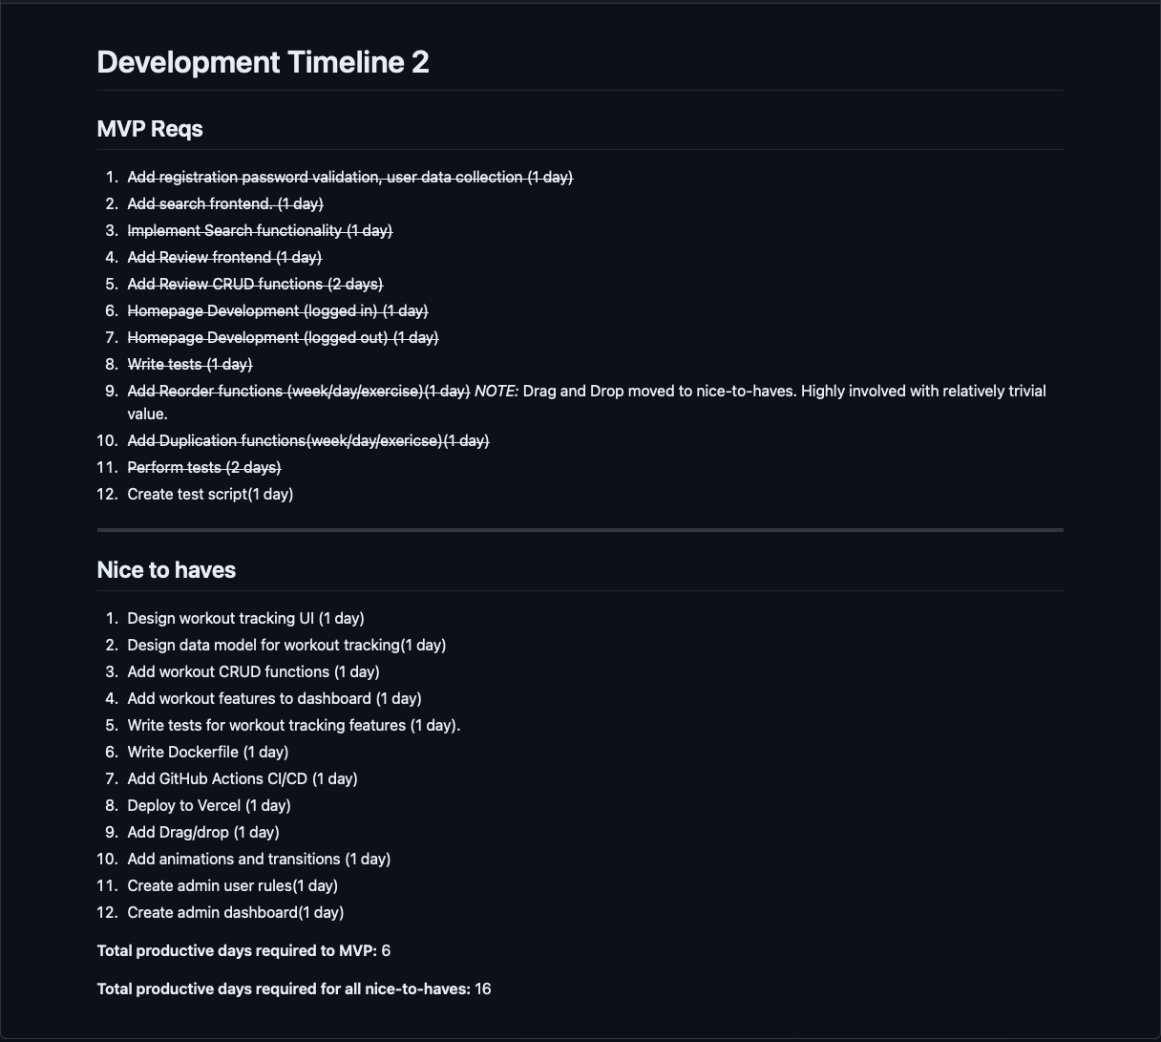
Development Timeline(Mid-Semester Refresh)

